Slide 1
Cryptography and Network Security
Chapter 5
Digital Signatures
Lectured by
Nguyễn Đức Thái

Slide 2
Outline
Digital Signatures
Digital Signature Algorithm and Standard

Slide 3
Digital Signatures
A digital signature is an authentication mechanism that enables the creator of a message to attach a code that acts as a signature.
Typically the signature is formed by taking the hash of the message and encrypting the message with the creator’s private key.
The signature guarantees the source and integrity of the message.
The digital signature standard (DSS) is an NIST standard that uses the secure hash algorithm (SHA).

Slide 4
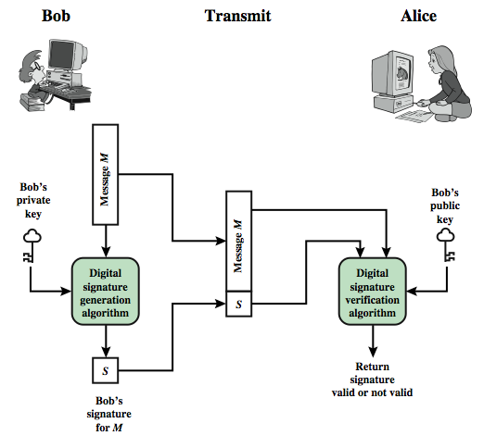
Digital Signature Model

Slide 5
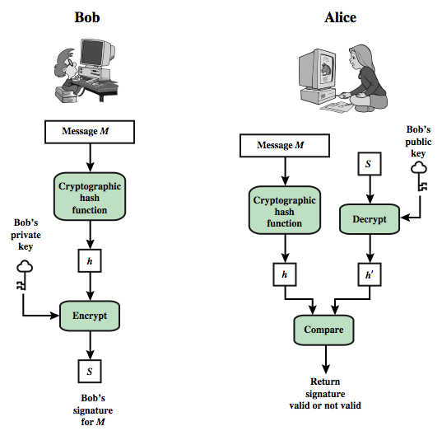
Digital Signature Model

Slide 6
Attacks and Forgeries
attacks
key-only attack
known message attack
generic chosen message attack
directed chosen message attack
adaptive chosen message attack
break success levels
total break
selective forgery
existential forgery

Slide 7
Digital Signature Requirements
must depend on the message signed
must use information unique to sender
to prevent both forgery and denial
must be relatively easy to produce
must be relatively easy to recognize & verify
be computationally infeasible to forge
with new message for existing digital signature
with fraudulent digital signature for given message
be practical save digital signature in storage

Slide 8
Direct Digital Signatures
involve only sender & receiver
assumed receiver has sender’s public-key
digital signature made by sender signing entire message or hash with private-key
can encrypt using receivers public-key
important that sign first then encrypt message & signature
security depends on sender’s private-key

Slide 9
Digital Signature Standard (DSS)
US Govt approved signature scheme
designed by NIST & NSA in early 90's
published as FIPS-186 in 1991
revised in 1993, 1996 & then 2000
uses the SHA hash algorithm
DSS is the standard, DSA is the algorithm
FIPS 186-2 (2000) includes alternative RSA & elliptic curve signature variants
DSA is digital signature only unlike RSA
is a public-key technique

Slide 10
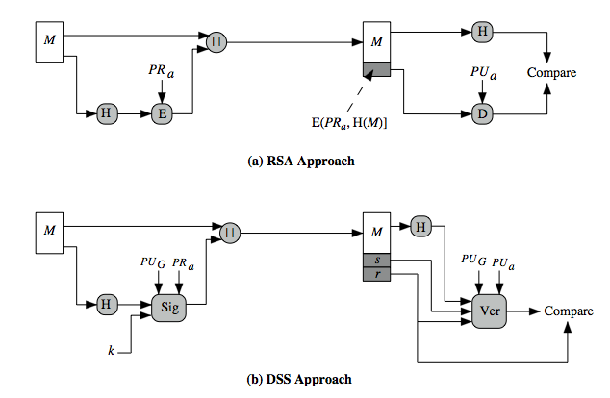
DSS vs. RSA Signatures

Slide 11
Digital Signature Algorithm (DSA)
creates a 320 bit signature
with 512-1024 bit security
smaller and faster than RSA
a digital signature scheme only
security depends on difficulty of computing discrete logarithms
variant of ElGamal & Schnorr schemes

Slide 12
DSA Key Generation
have shared global public key values (p,q,g):
choose 160-bit prime number q
choose a large prime p with 2^{L-1} < p < 2^{L}
where L= 512 to 1024 bits and is a multiple of 64
such that q is a 160 bit prime divisor of (p-1)
choose g = h^{(p-1)/q}
where 1<h<p-1 and h^{(p-1)/q} mod p > 1
users choose private & compute public key:
choose random private key: x<q
compute public key: y = g^{x} mod p

Slide 13
DSA Signature Creation
to sign a message M the sender:
generates a random signature key k, k<q
Note: k must be random, be destroyed after use, and never be reused
then computes signature pair:
r = (g^{k} mod p)mod q
s = [k⁻¹(H(M)+ xr)] mod q
sends signature (r,s) with message M

Slide 14
DSA Signature Verification
having received M & signature (r,s)
to verify a signature, recipient computes:
w = s⁻¹ mod q
u1= [H(M)w] mod q
u2= (rw) mod q
v = [(g^{u1} y^{u2}) mod p] mod q
if v=r then signature is verified
see Appendix A for details of proof why

Slide 15
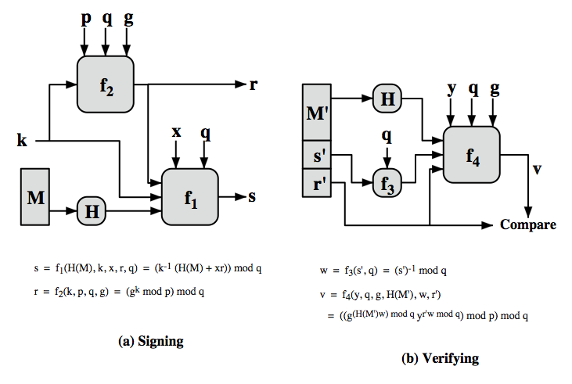
DSS Overview

Slide 16
Summary
We have discussed:
Digital Signatures
Digital Signature Algorithm and Standard

Slide 17
References
Cryptography and Network Security, Principles and Practice, William Stallings, Prentice Hall, Sixth Edition, 2013

